Slide 1
2024 TLS Intern Project Kickoff
RMS Intern Program
Christopher Shepherd, Isaac Martins
Intern Program TLS Project Leads
CN: AD ext. ITP

Slide 2
Agenda
Introductions
Roles and Responsibilities
RMS Intern Project Overview
TLS Project Overview
TLS Project Execution
TLS Project Deliverables
TLS Project Timeline
Expectations
Charging Guidance
Open Floor

Slide 3



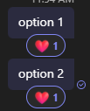


Around the Room
Does pineapple belong on pizza?
Yes
No
Is water wet?
Yes
No
Is a hotdog a sandwich or a taco?
Sandwich
Taco
Is cereal a soup?
Yes
No
Are you excited to be a 2024 LM Intern?
Yes!
Vote in meeting chat by using message reactions!

Slide 4

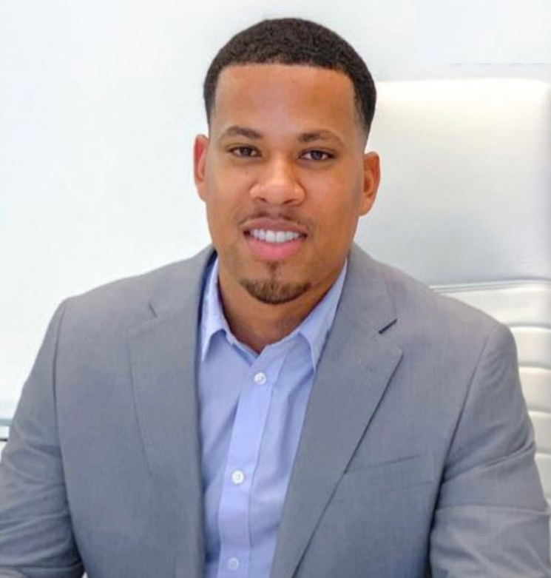
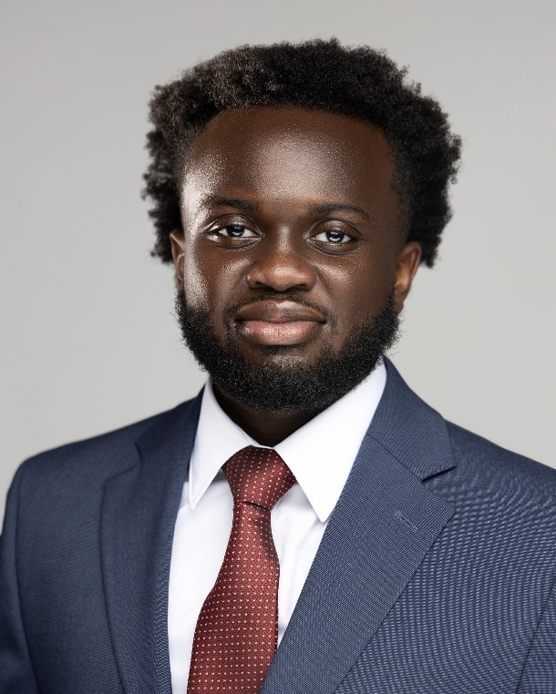
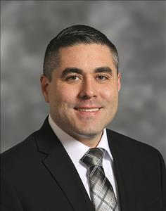
Introductions
Christopher Shepherd
TLS Project Lead
2018 Quality Engineer Intern
2019 Flight Controls Intern
2023 Intern Mentor & D&I mentorship Chair
2024 Intern Project Lead
Current job at LM: Engineering LDP - Business Development TA
Isaac Martins
TLS Project Lead
Intern Mentor last year
Current job at LM: Engineering LDP
Adam Breed
TLS Project SME
We’ll let Adam tell you about himself later this week!
Current job at LM: Systems Architect Principal
Notes:
All

Slide 5
Roles and Responsibilities
Site Coordinator | LOB Project Lead
Responsible for all site activities Technical Events Networking Events Social Events Provides support for all non-project related issues Not affiliated with Intern Project | Responsible for execution of Intern Project Answers all questions pertaining to Intern Project Plans LOB project lectures Provides guidance and instruction on project through summer Not affiliated with site-based events
Project questions should be directed to Project Leads

Slide 6
RMS Intern Project Overview
IWSS
SAC
TLS
Integrated Laser Weapon System
Training Modules of the Future
C6ISR
RMS Lines of Business
Integrating AI Interfaces
Wildfire Drone Advancements
To enhance the efficiency and effectiveness of C6ISR operators, there is a need to develop an intelligent interface that can assist operators in processing and analyzing large volumes of data in real-time
To leverage and expand on proven laser weapon system capability, there is a need to generate an integrated approach for a non-hit to kill system against hypersonic threats.​ ​IWSS requires a solution that touches upon laser design, radar design, and hypersonic defense
To prevent and eliminate wildfires, there is a need to develop an Aerial Firefighting System that can be used to identify wildfires and relay information to a Command and Control (C2) station
To stay on top of new technological advancements, there is a need to create a training solution that is on the cutting edge of technology and provides service members with the most realistic and immersive experience possible

Slide 7
RMS TLS Overview
Aircrew & Maintainer Training
Land Training
Maritime Training
Resilient Logistics and Sustainment Solutions

Slide 8
TLS Project Overview
As a leading organization dedicated to training and sustainment, TLS understands the significance of anticipating and adapting to changes in the industry. In efforts to stay ahead of ready, you are expected to:
Conducting a thorough review of LM resources is recommended to gain a more comprehensive and in-depth understanding of the business, including its operations, challenges, opportunities, and potential for improvement and innovation.
Assess revolutionary technologies, methodologies, and concepts that will formulate the future defense training landscape.
Anticipate future military personnel needs and develop a detailed plan of a next generation training enterprise and any associated educational concepts for the military of 2035.

Slide 9
TLS Project Execution
TLS Overview & Strategy Lecture
6/18: 10am-11am
Adaptive Learning Lecture
6/19: 11am-12am
Industry Day
6/20: 3pm-4pm
Office Hours
Weekly starting 6/24 until demo day (Specific Day: TBD)
Team Breakouts
Suggesting that the team meets at least once every week but, teams have the choice to choose their own cadence.

Slide 10
TLS Project Deliverables
Identify future strengths, weakness, opportunities and threats to a training enterprise provider (SWOT analysis)
Propose a reimagined training enterprise
Create ConOps to visually represent this future training enterprise
High-level business case analysis
Final PowerPoint Presentation

Slide 11
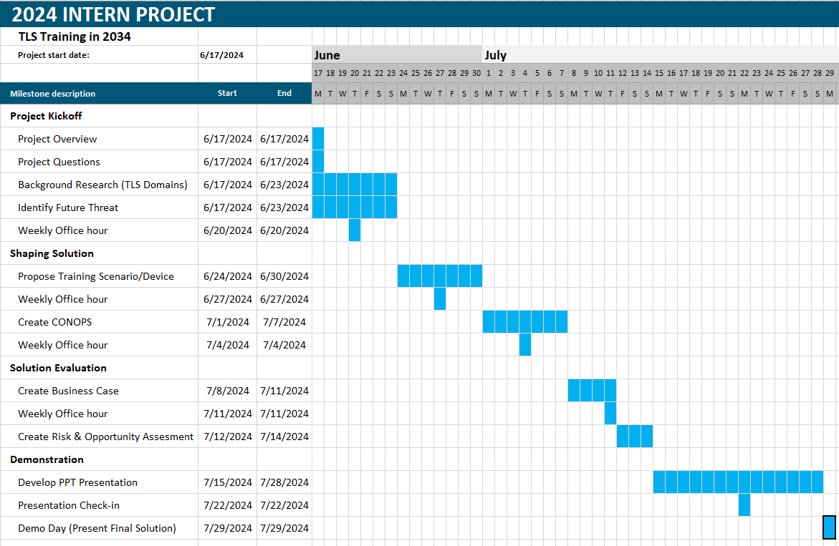
TLS Project Timeline

Slide 12
Expectations
Perform with excellence
Model personal integrity and accountability
Don’t be afraid to ask questions
Apply a growth mindset
Prioritize the Intern Program events (site and project)
Charge your time accurately
Have fun!

Slide 13
TLS Charging Guidance
More details on Charging will be provided in an email after the meeting
Project Event | Charge Number | Maximum
Project Kickoff | AD-ITP | 1 hr.
Project Lectures | MT-ITR | 4 hr.
Project Working Time | AD-ITP | 16 hr.
Final Project Demonstration | AD-ITP | 3 hr.

Slide 14
Actions Required
Review Statement Of Work (SOW)
Send Calendar invite for initial team meeting (today/tomorrow)
- Set up recurring team meeting once a week (minimum)
- Develop a list of questions for industry day

Slide 15
Open Floor

